Slide 1

Hack for good covid-19
“PRotect the society”
Project by:
Aishani Mukerji
Ashish L Parmar
Koustav Pal
Prithivi guha
SharIka Anjum mondal

Slide 2

COVID-19 will reshape our world. We don't yet know when this crisis will end. But we can be sure that by the time is does, our world will look very different .
Josep Borrell

Slide 3
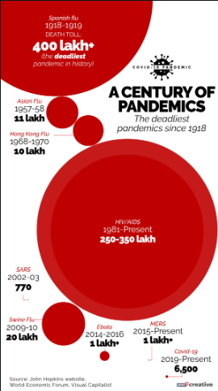
HISTORY
The first case of the 2019–20 coronavirus pandemic in India was reported on 30 January 2020, originating from China.
The outbreak has been declared an epidemic in more than a dozen states and union territories, where provisions of the Epidemic Diseases Act, 1897 have been invoked.

Slide 4
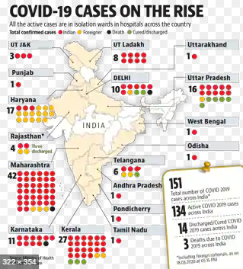
HISTORY
India has suspended all tourist visas, as a majority of the confirmed cases were linked to other countries. India has suspended all tourist visas, as a majority of the confirmed cases were linked to other countries.
Further, on 24 March, the prime minister ordered a nationwide lockdown for 21 days, affecting the entire 1.3 billion population of India.

Slide 5
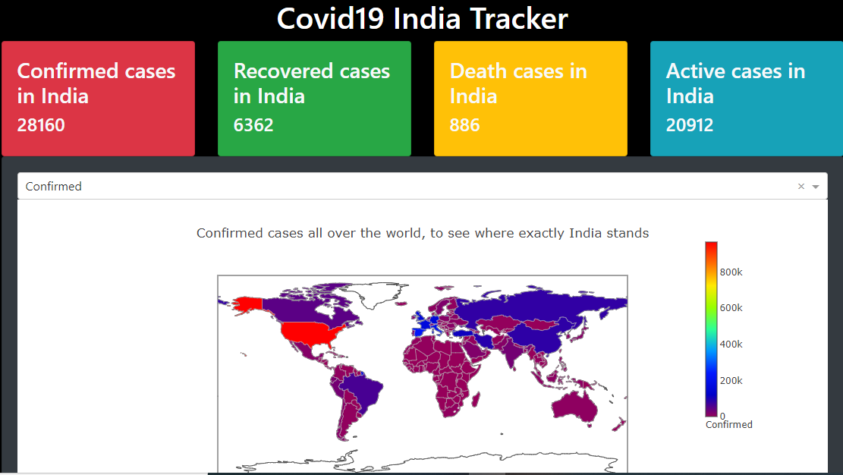
Abstract
Keeping the current situation in mind , we have come up with an idea to help the Government curb this pandemic from spreading in our country. These days usage of mobile apps has increased so our solution is in the form of an app .
The app will contain data about worldwide hotspots , where India stands, testing centres , affected , recovered , deaths, age probability, gender probability to be affected etc . In India is included.Look on for further details.

Slide 6

PROCEDURE
We used Pycharm , plotly, dash and concepts of data analysis to make different types of data analysis.
We have made all of types of graphs such as pie chart, bar graphs, donuts, heat maps etc.
The process we went through was:
data mining->data re-organising->plotting-> uploading in dash->adding to app going to be prepared.

Slide 7
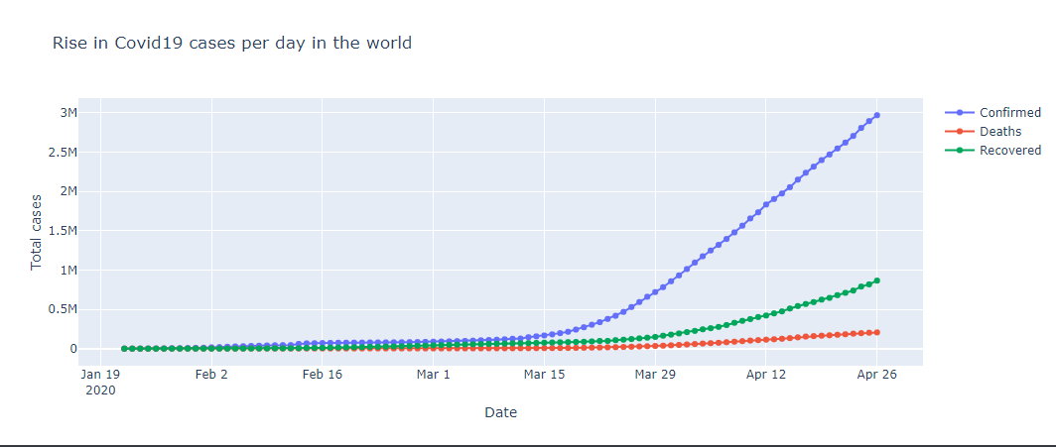
FEATURE 1:
It will have an in built Covid19 tracker , which will have all the following dynamic data :
(i). Number of positive cases , death cases and recovered cases.
(ii). Hotspots of each state and district marked in the map .
(iii). Graphs of Recovery Rate , Increase in Covid cases.

Slide 8
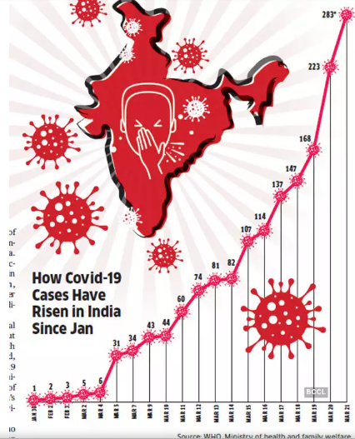
CONTD.
(iv). Gender Probability , Mortality Rate , Fatality Rate .
(v). Total number of Covid19 hospitals in each state .
(vi). Total number of beds allotted by each state

Slide 9
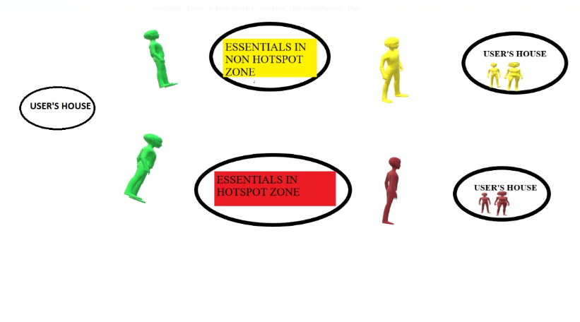
FEATURE 2:
This app will have access to the user’s location and will be tracking the movement.

Slide 10
CONTD.
When the user leaves the house to get some essentials , it is marked as yellow and if the user goes into a hotspot then the user will be marked as red . Once , the red user comes back home , the entire family is marked as red .
This feature is implemented keeping the importance of quarantine and social distancing in mind .
The user will be marked green only when the yellow marked user is spends at least 4 days at home in quarantine and the red marked user will have to spend at least 7 days at home .

Slide 11
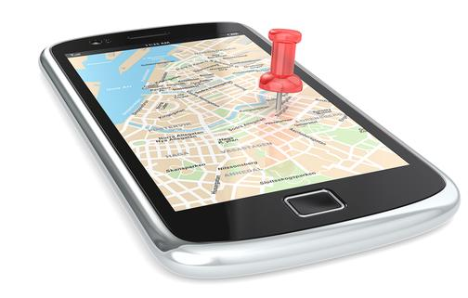
FEATURE 3:
The police and the user will be notified if any red user is around by the notification system mentioning the distance from the user.
FEATURE 4:
The police and the medical staff using this app will have a feature of tracking the red users in the map .

Slide 12
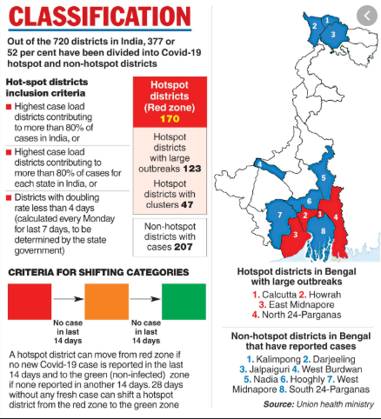
FEATURE 5:
As per the government instructions the people living in the hotspot areas aren’t allowed to leave their house , these users will be marked permanently red. And any movement in that area will be notified to the police and the medical staff .
FEATURE 6:
This app will also inform the user the nearest store where the user can get the essentials when he/she moves out of the house .

Slide 13
Serviceability
It is a an app which can be referred to for all the essential information and analysis related to COVID-19.
It also gives the predictive model showing the growth of the pandemic. Accordingly steps can be taken after a glance.
It will also help in keeping a track of the suspected users.
And also help the users to keep themselves out of danger.

Slide 14
For further details PLEASE REFER TO the dashboard made by us(link given below):
https://coronavirus-india-tracker.herokuapp.com/
(PLEASE COPY PASTE THE LINK IF IT DOESN’T OPEN ON CLICKING, WE RECOMMEND TO OPEN IT IN A LAPTOP FOR A BETTER VIEW.)

